Slide 1
New Product Sales Forecast
Team - CLUSTERX
Asish Chakrapani Twinkle Jaswani
Varun goel vedaanti Baliga

Slide 2
Problem Statement
IMPROVE MARKETING FORECAST FOR NEWLY LAUNCHED PRODUCT.
WHY MARKETING FORECAST?
Potential of the new product.
Sales Planning
Demand Forecasting.
Higher ON TIME & IN FULL Delivery.
Inventory Controls.
Price Stability.

Slide 3
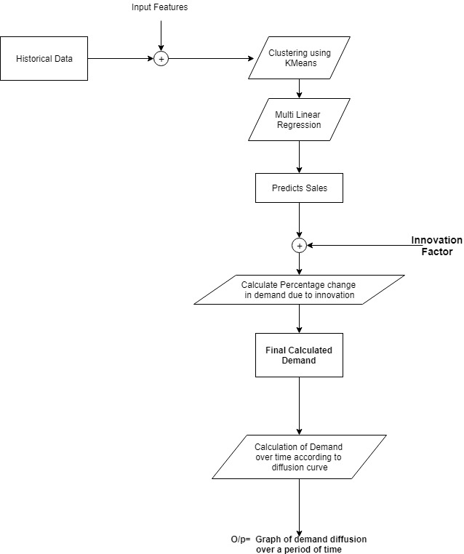
Model Architecture
Input Features:
Common Features:
RAM
CPU speed
Memory
Screen Size
Price
New Features
Potential calculated through Innovation factor

Slide 4
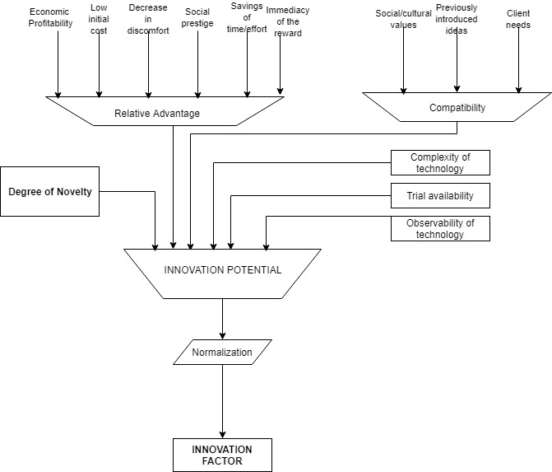
Innovation Potential – An Overview

Slide 5
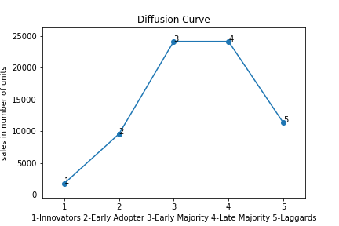
Diffusion of Innovation (DOI) Model.
This model helps a business to understand how a buyer adopts and engages with new products or technologies over time.
Companies will use it when launching a new product or service, adapting it or introducing an existing product into a new market.
Particularly useful when launching new products.

Slide 6
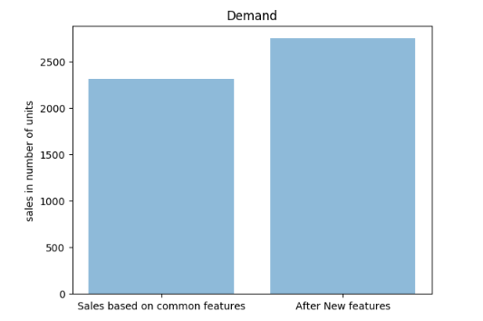
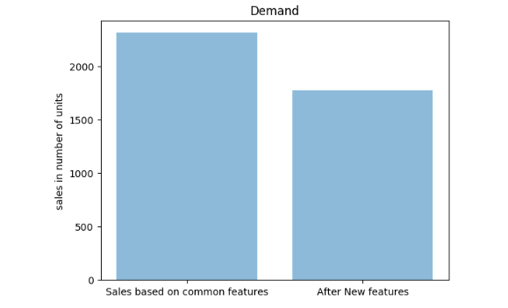
Comparison of Results:

Slide 7

UI Development and Integration
Developed a Web Application.
Flask is a microframework.
Creates a virtual environment.
Has integration facilities.

